Slide 1
Introduction to Computing for Data Analysis
Linear regression
Richard Vuduc, Ph.D.
Associate Professor
School of Computational Science and Engineering
An online algorithm
Notes:
Hi and welcome back.
Now so far we are solving the regression problem assuming that we get to see all of the data at once.
But what if you only get to see it one data point at a time?

Slide 2
Introduction to Computing for Data Analysis
Linear regression
Richard Vuduc, Ph.D.
Associate Professor
School of Computational Science and Engineering
An online algorithm
Notes:
In that case, you still want to fit a model using whatever data you’ve seen so far.
But then, when you get a new data point, you want to update the model to reflect the new information.
This lesson is about just such a method to do so.

Slide 3
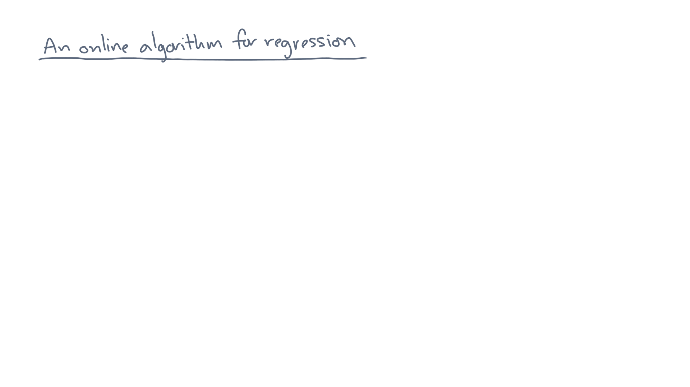
Notes:
We’ll refer to this algorithm as being “online.”

Slide 4


Slide 5
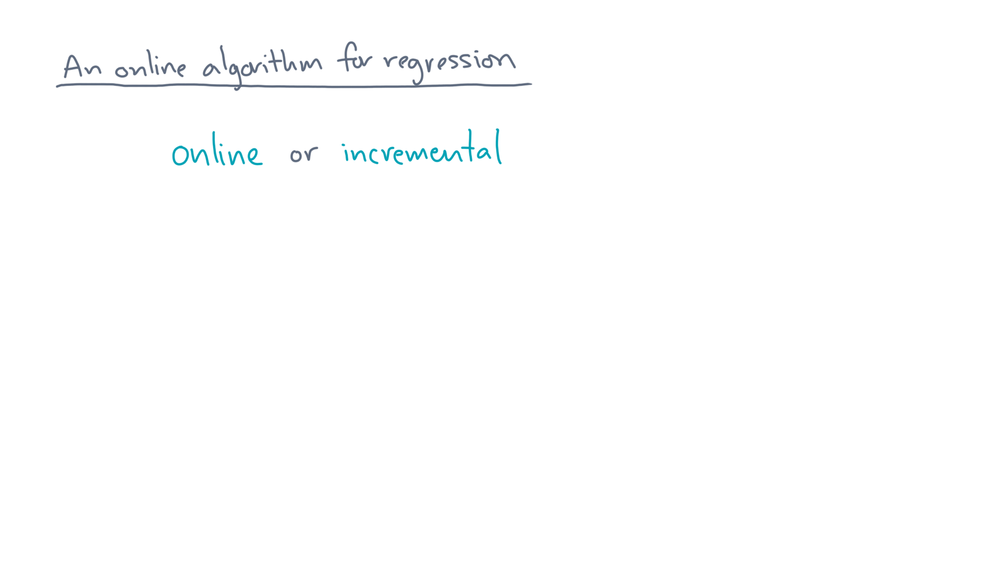
Notes:
A synonym is “incremental.”
Again, the idea is that you see only one or maybe a few data points at a time.

Slide 6
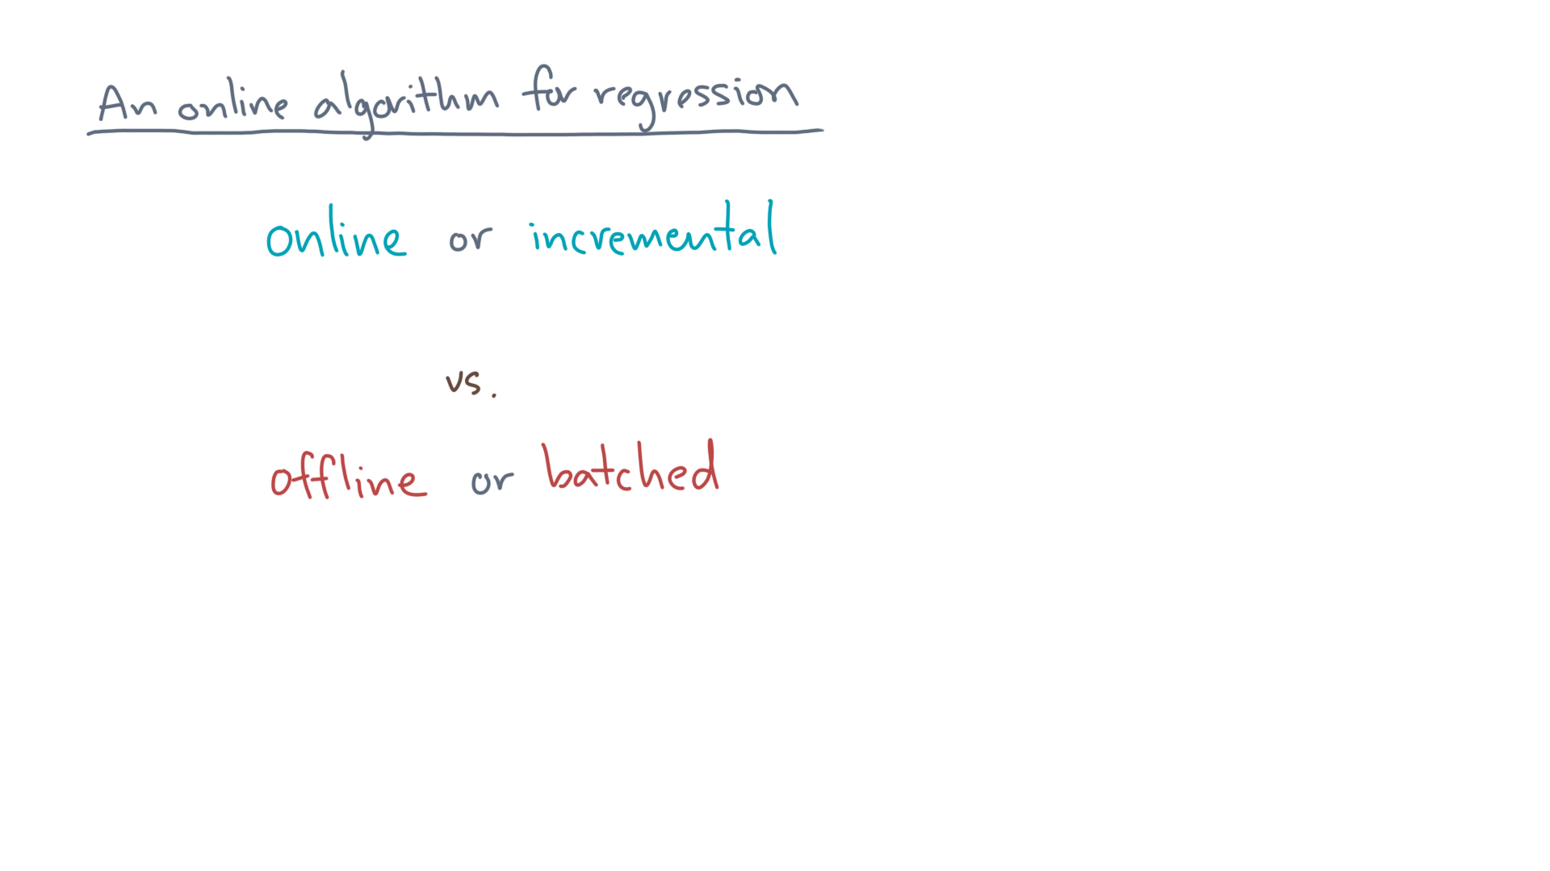
Notes:
By contrast, the methods you’ve seen so far are “offline” or “batched.”
They assume you see all the data at once.
So why the distinction?

Slide 7
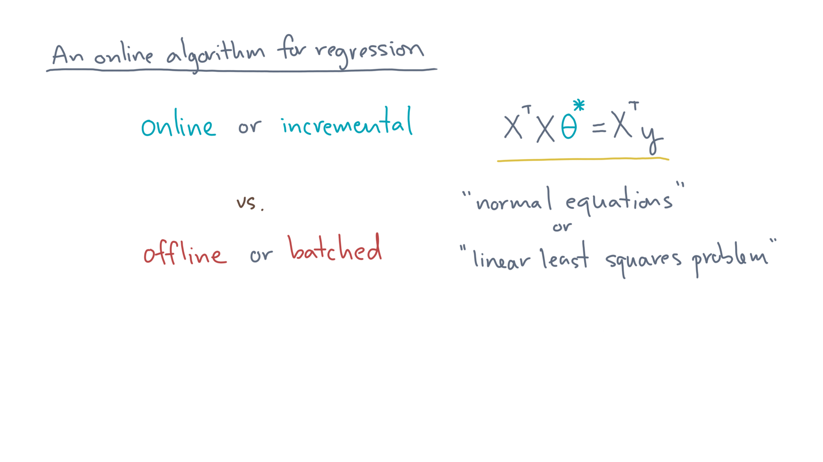
Notes:
Well, for linear regression, recall that you need to solve the normal equations.

Slide 8
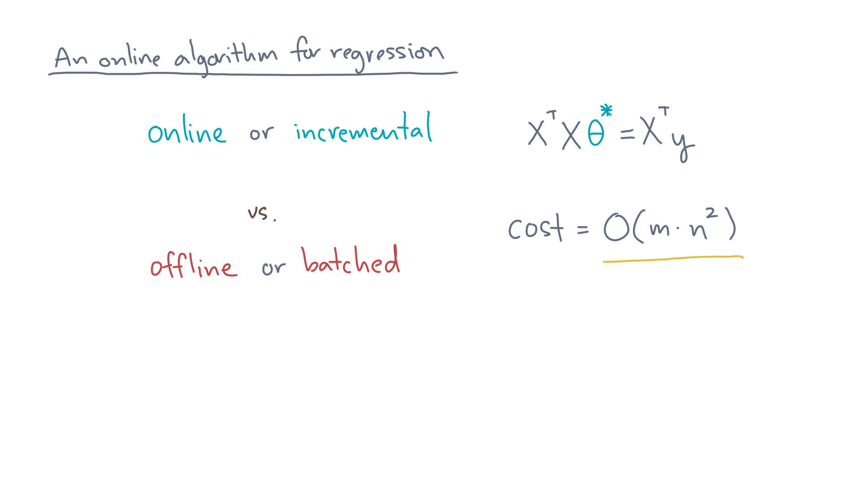
Notes:
To solve it once incurs a running time cost of m-times-n-squared, where m is the number of observations and n is the number of predictors.
That’s reasonable – at least it’s linear in the number of observations.

Slide 9
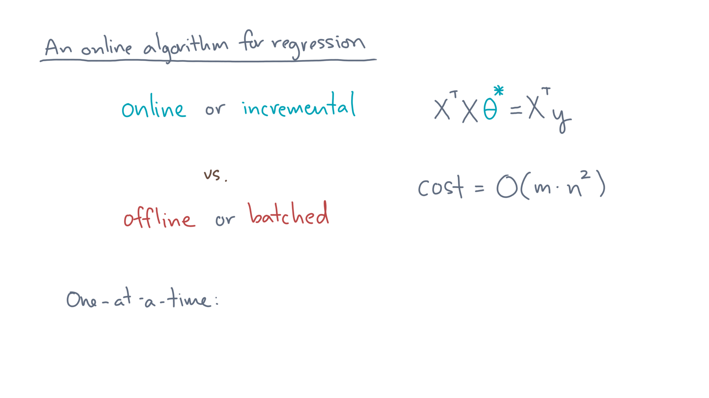
Notes:
Now suppose you see one point at a time, and you solve the normal equations from scratch each time.
What would that cost?

Slide 10
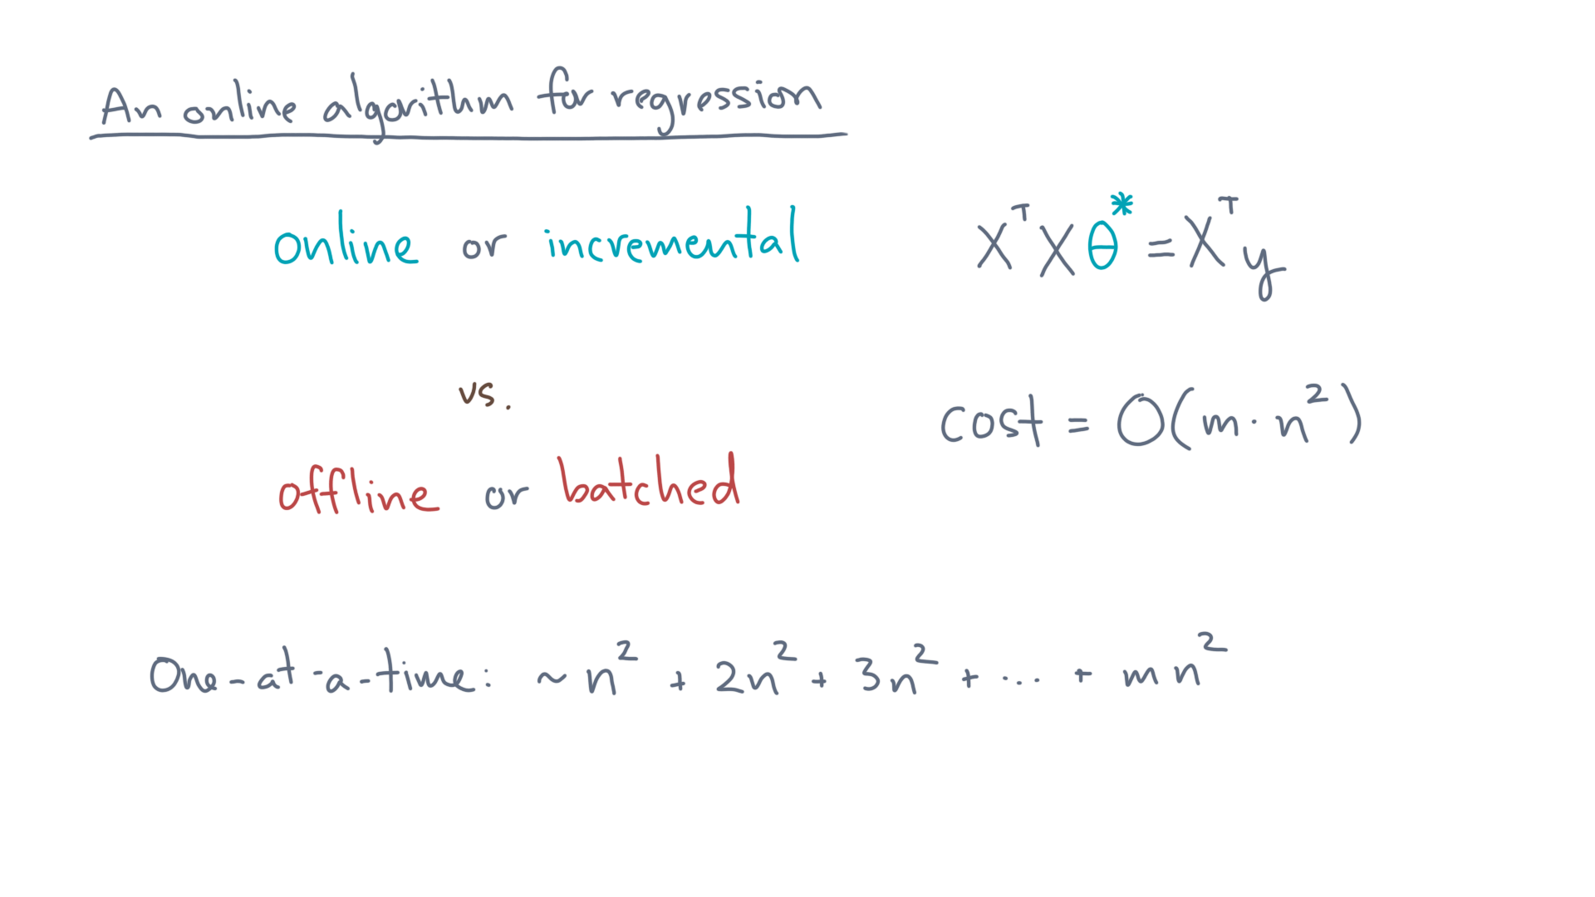
Notes:
Then the cost would be this series: n-squared plus 2-n-squared + 3-n-squared and so on up to m-n-squared.

Slide 11
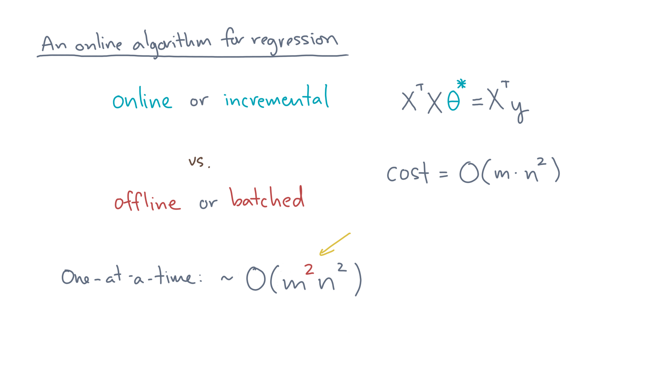
Notes:
That’s an approximate total of m-squared-times-n-squared operations, which is a factor of “m” worse in aggregate!

Slide 12
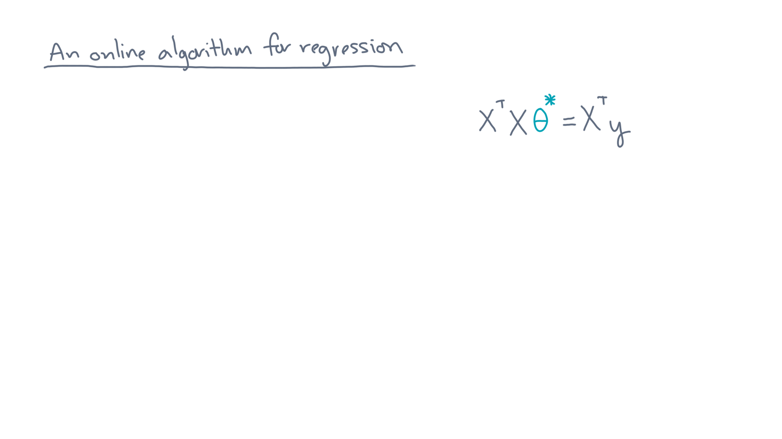
Notes:
So we need another approach.
First, some notation.

Slide 13
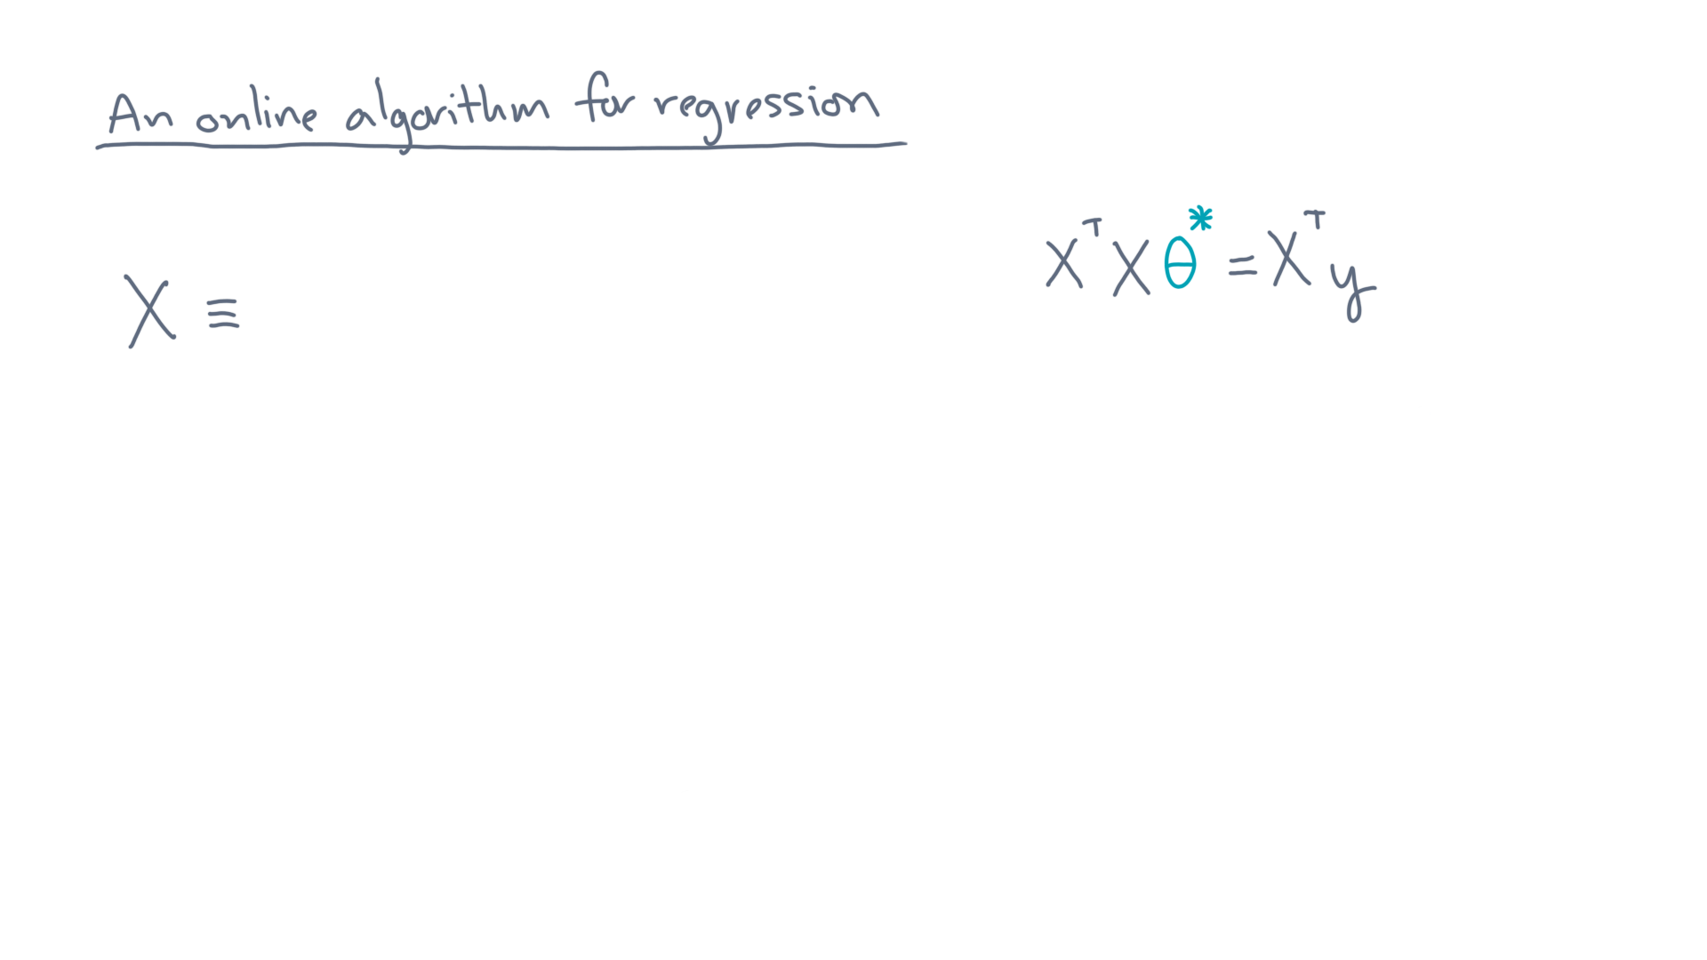
Notes:
Recall that we have two ways to view the data matrix.

Slide 14
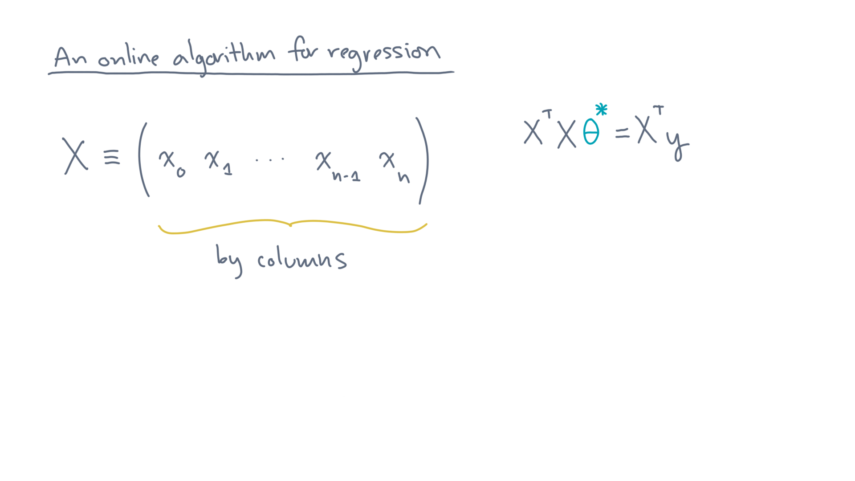
Notes:
The first is “by column.”
Let’s say there are n+1 columns.

Slide 15
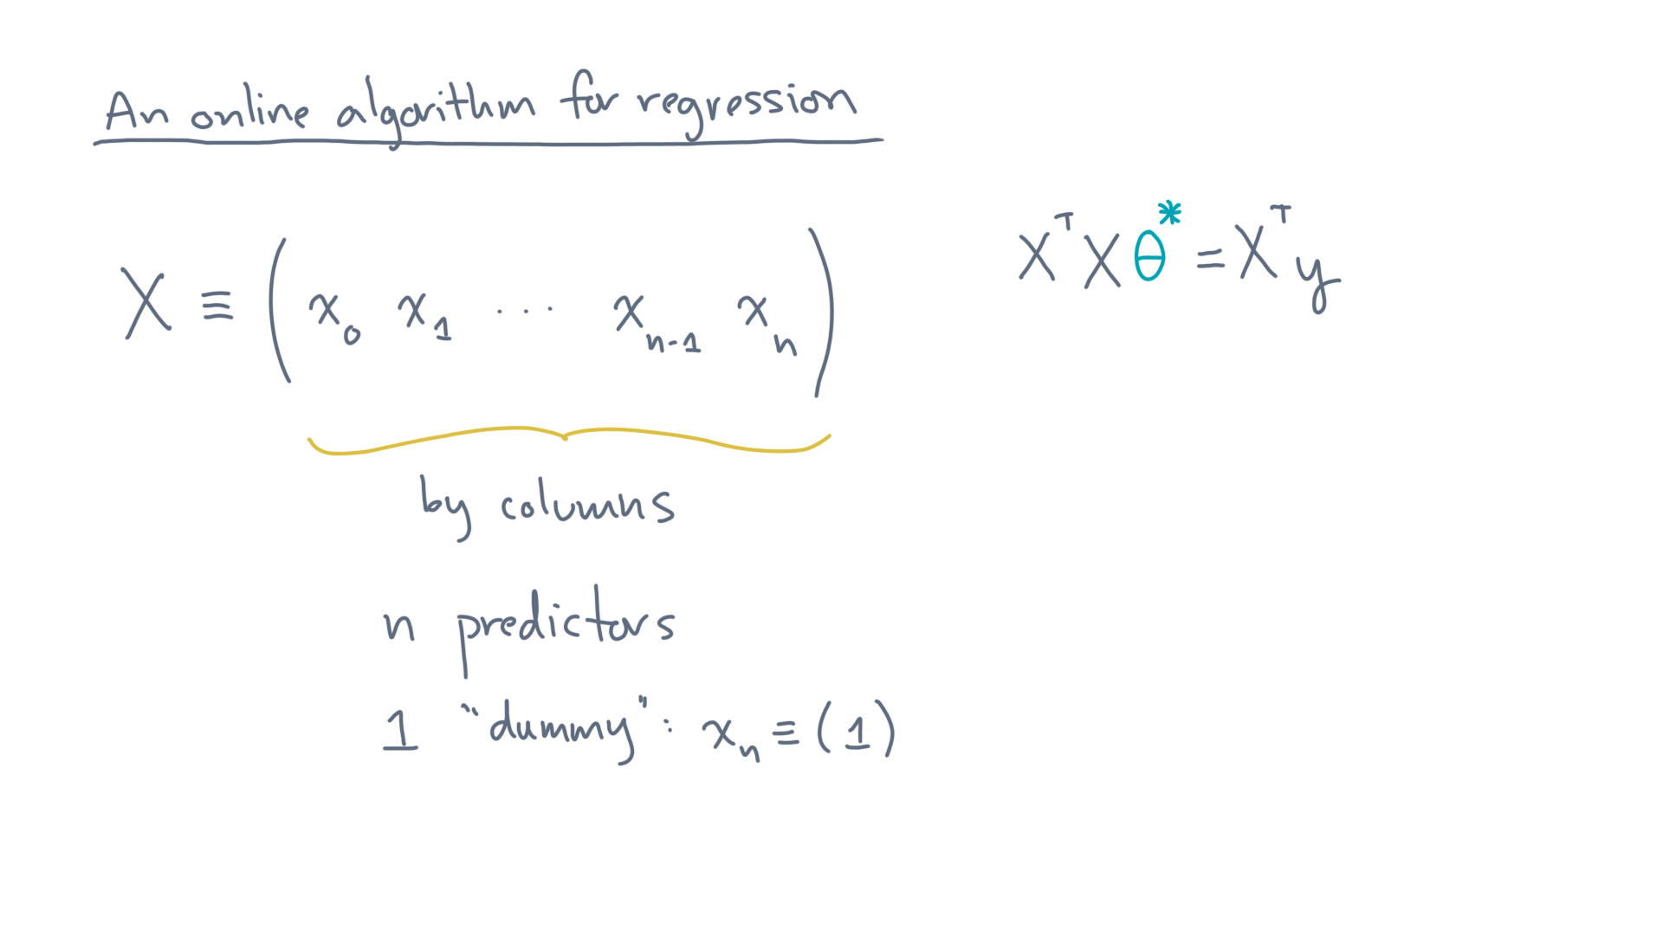
Notes:
Each column refers to a predictor variable, except the last column, which has all one values.

Slide 16
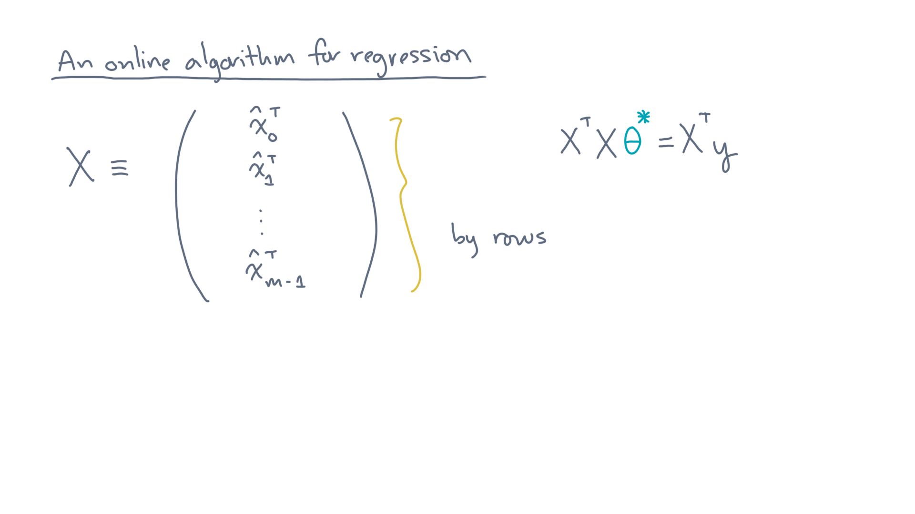
Notes:
The other equivalent view is by rows.

Slide 17
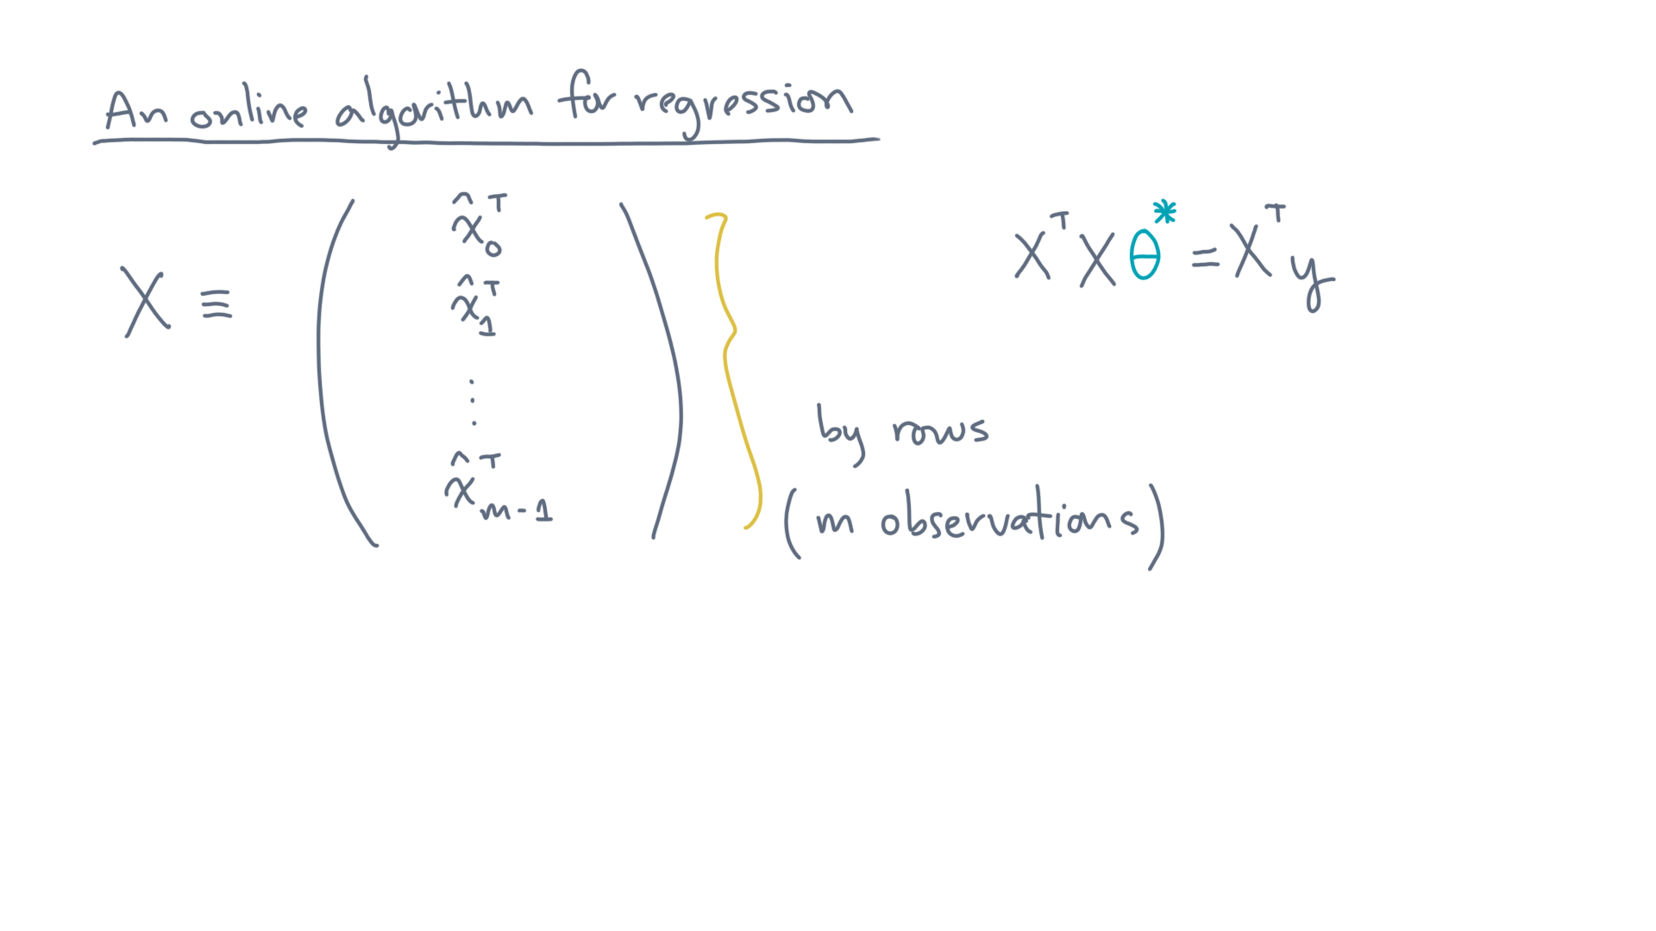
Notes:
Each of the m rows is an observation.
We’ll use x-hat when referring to observations, and the “transpose” reminds us when we need to view an observation as a row vector.

Slide 18
Notes:
Now let’s consider the online setting.

Slide 19
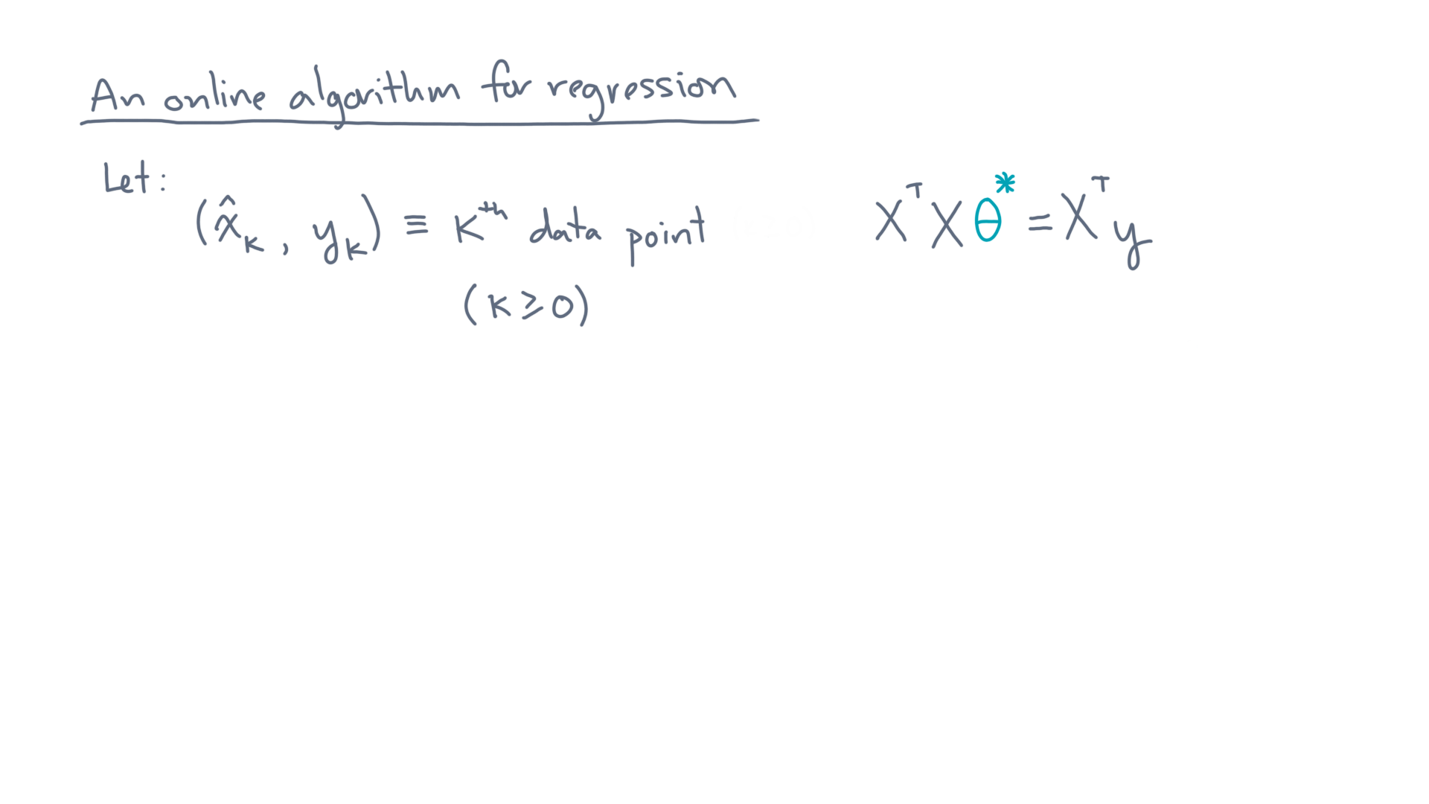
Notes:
Suppose the k-th data point, x-hat-k, and its response, y-k, arrive.

Slide 20
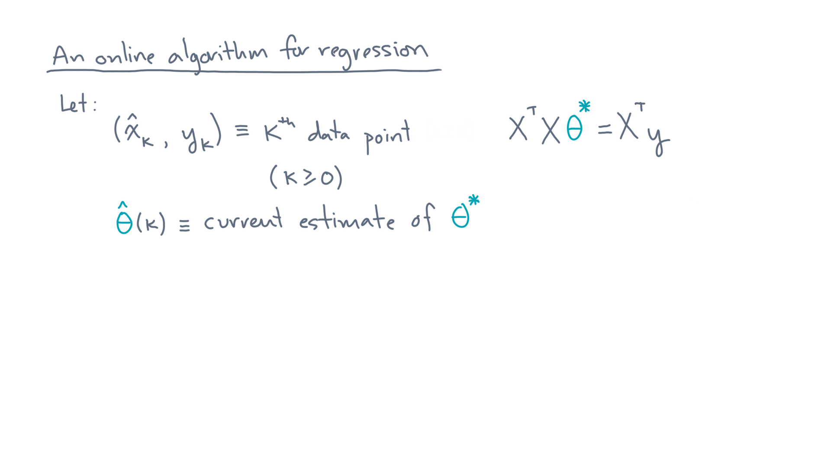
Notes:
And let’s suppose theta-hat-of-k is our current parameters estimate.

Slide 21
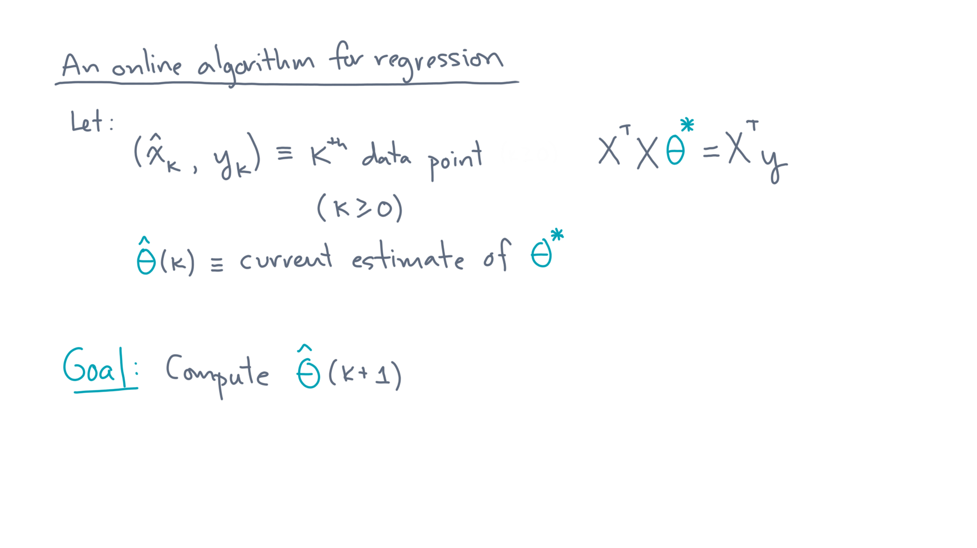
Notes:
Our computational goal is to update this estimate, producing a new estimate, theta-hat-of-k-plus-one.

Slide 22
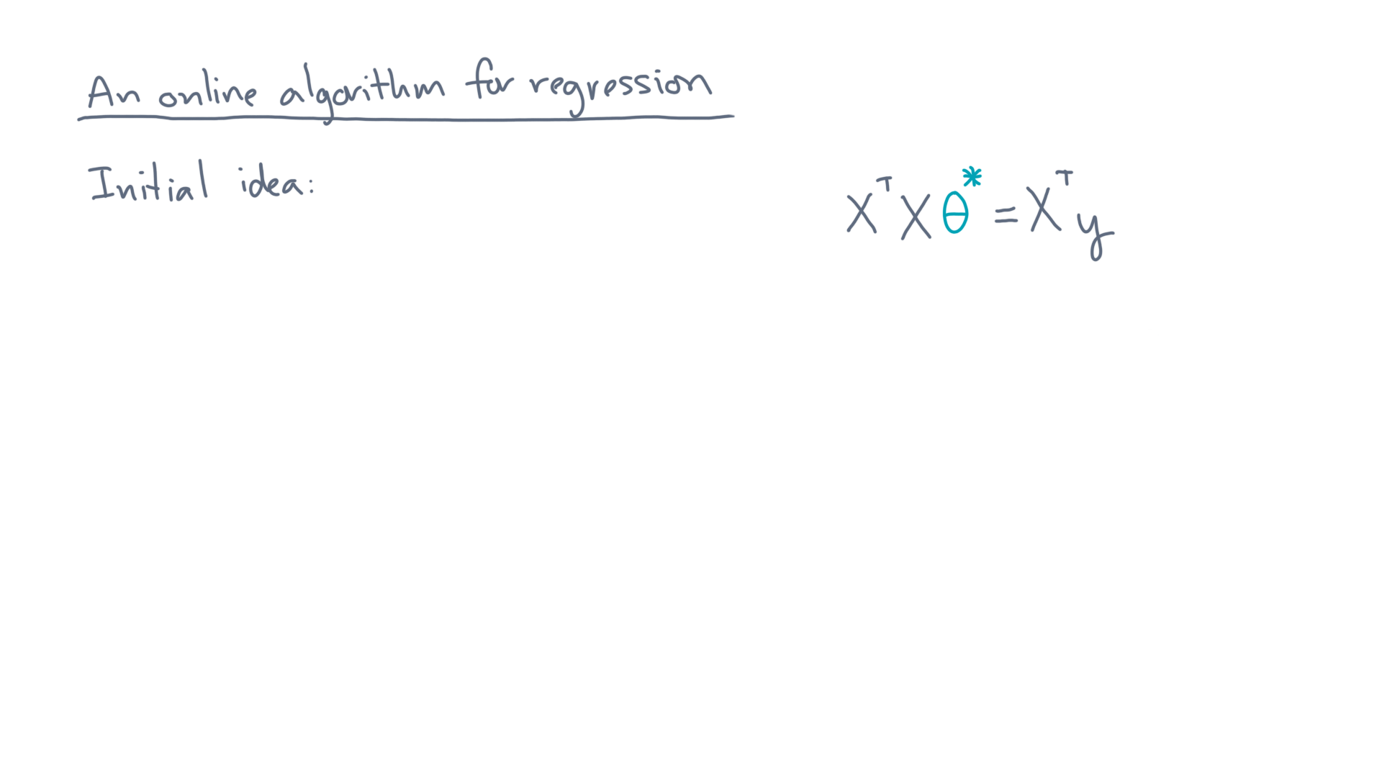
Notes:
Here’s an initial, albeit flawed, idea.

Slide 23
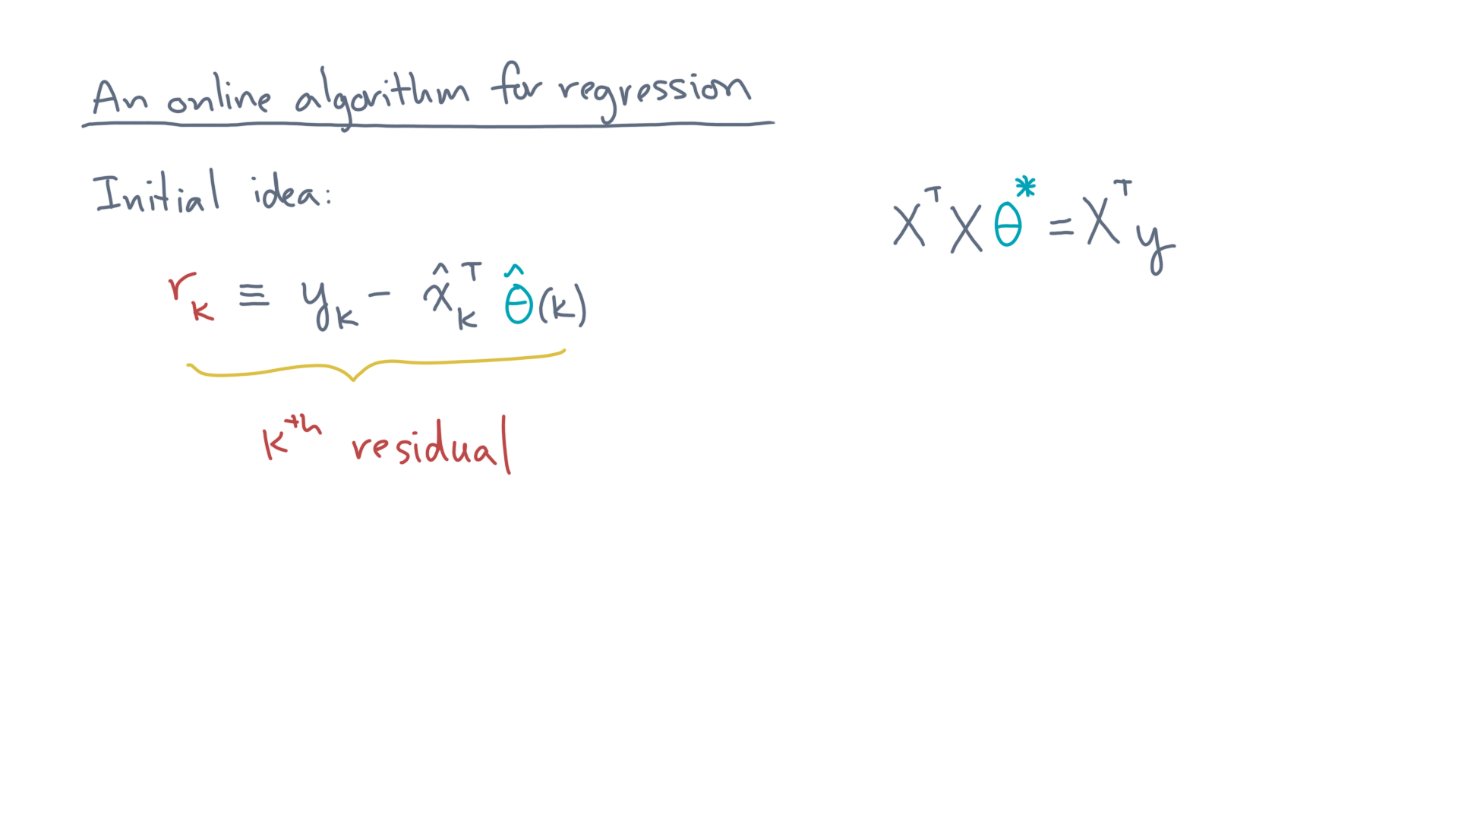
Notes:
Let r-k be the k-th residual.
That is, the difference between the true response, y-k, and the predicted response, x-hat-k transpose times theta-hat-k.

Slide 24
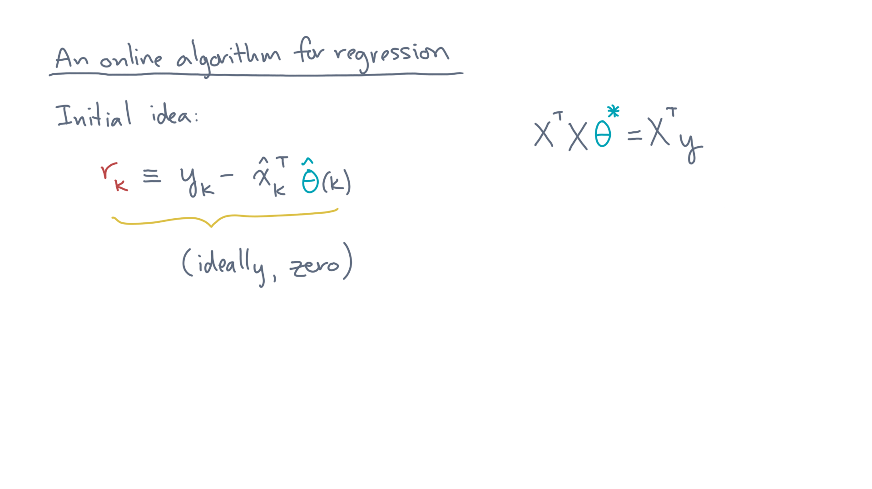
Notes:
Ideally, the k-th residual is zero, but that’s unlikely.
After all, our model estimate, theta-hat-k, is based only on points we’ve seen so far, not the new point nor any future points.

Slide 25
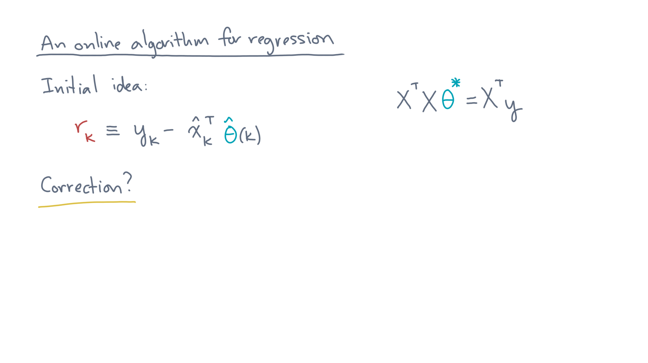
Notes:
So let’s try to “correct” the current parameter estimate.

Slide 26
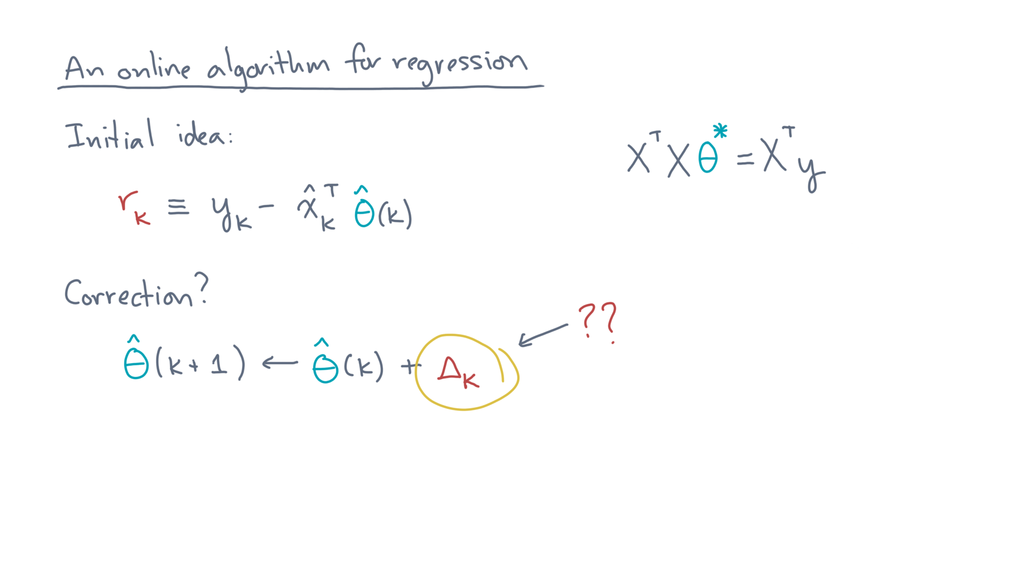
Notes:
That is, relative to the current estimate, let’s “add” a correction, Delta-k, to get a new estimate.
What should Delta-k be?

Slide 27
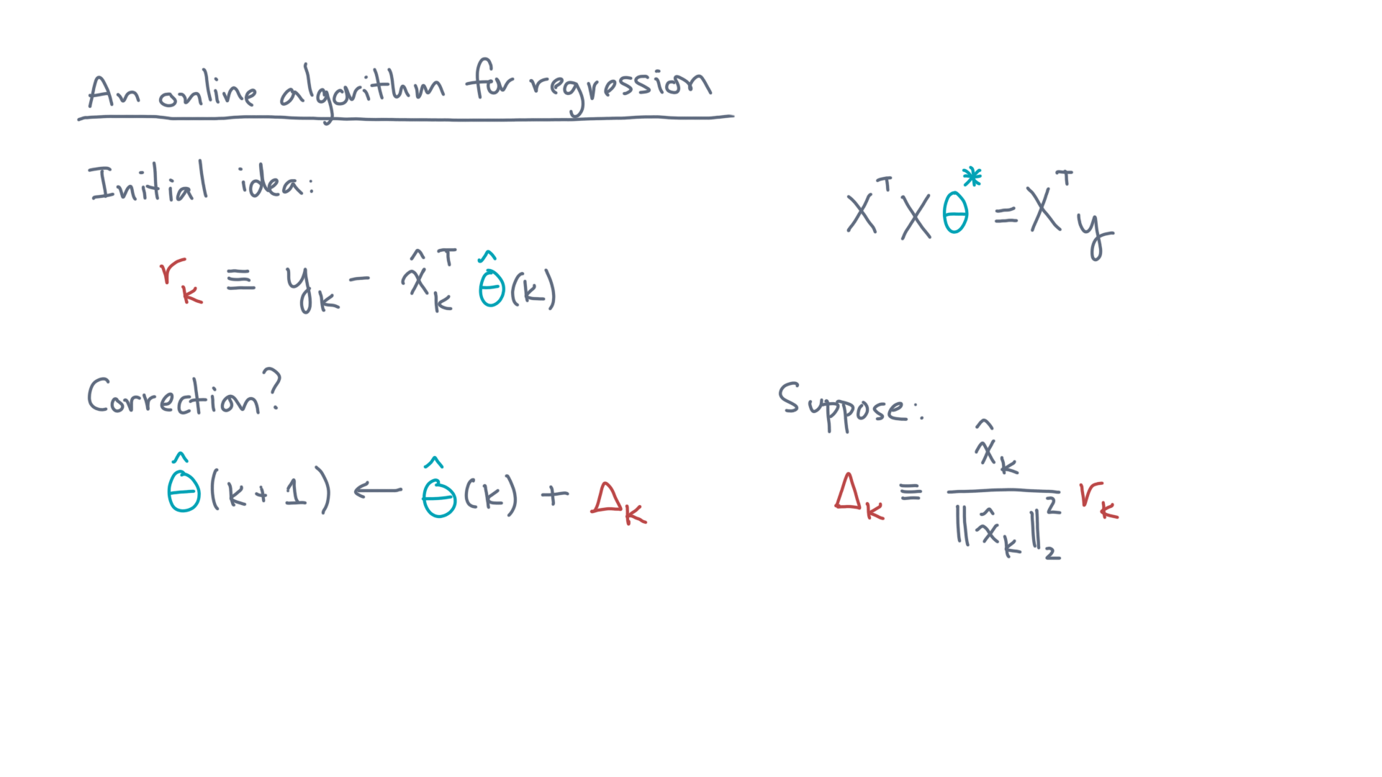
Notes:
Suppose you choose Delta-k to be this quantity:
X-hat-k divided by its length-squared, times r-k.

Slide 28
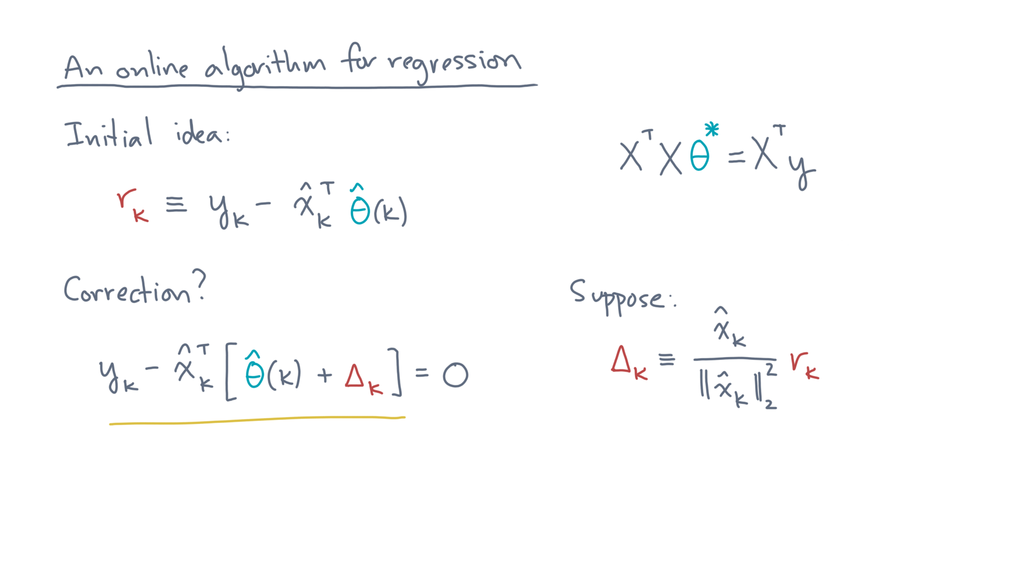
Notes:
Then you can show that this new estimate zeroes-out the error on the k-th data point.
So what’s the flaw in this scheme?

Slide 29
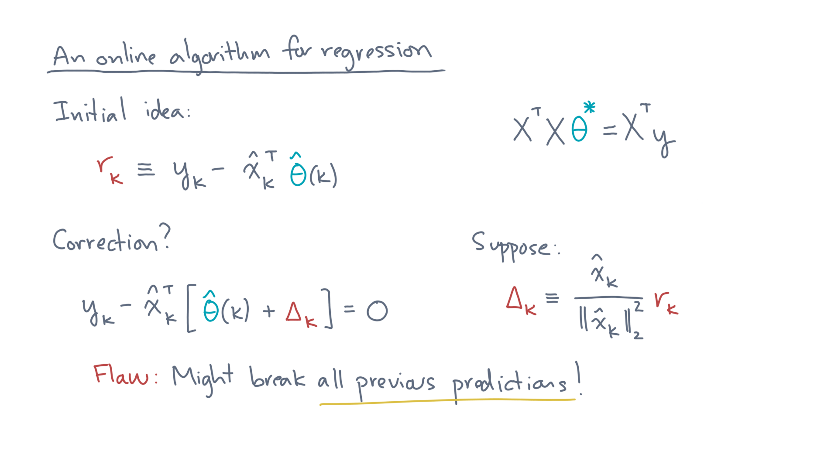
Notes:
Well, you might get this point right but break all previous predictions!
Remember, we want parameter estimates that are “good” on all the data.

Slide 30
Notes:
Ok, so back to the drawing board.

Slide 31
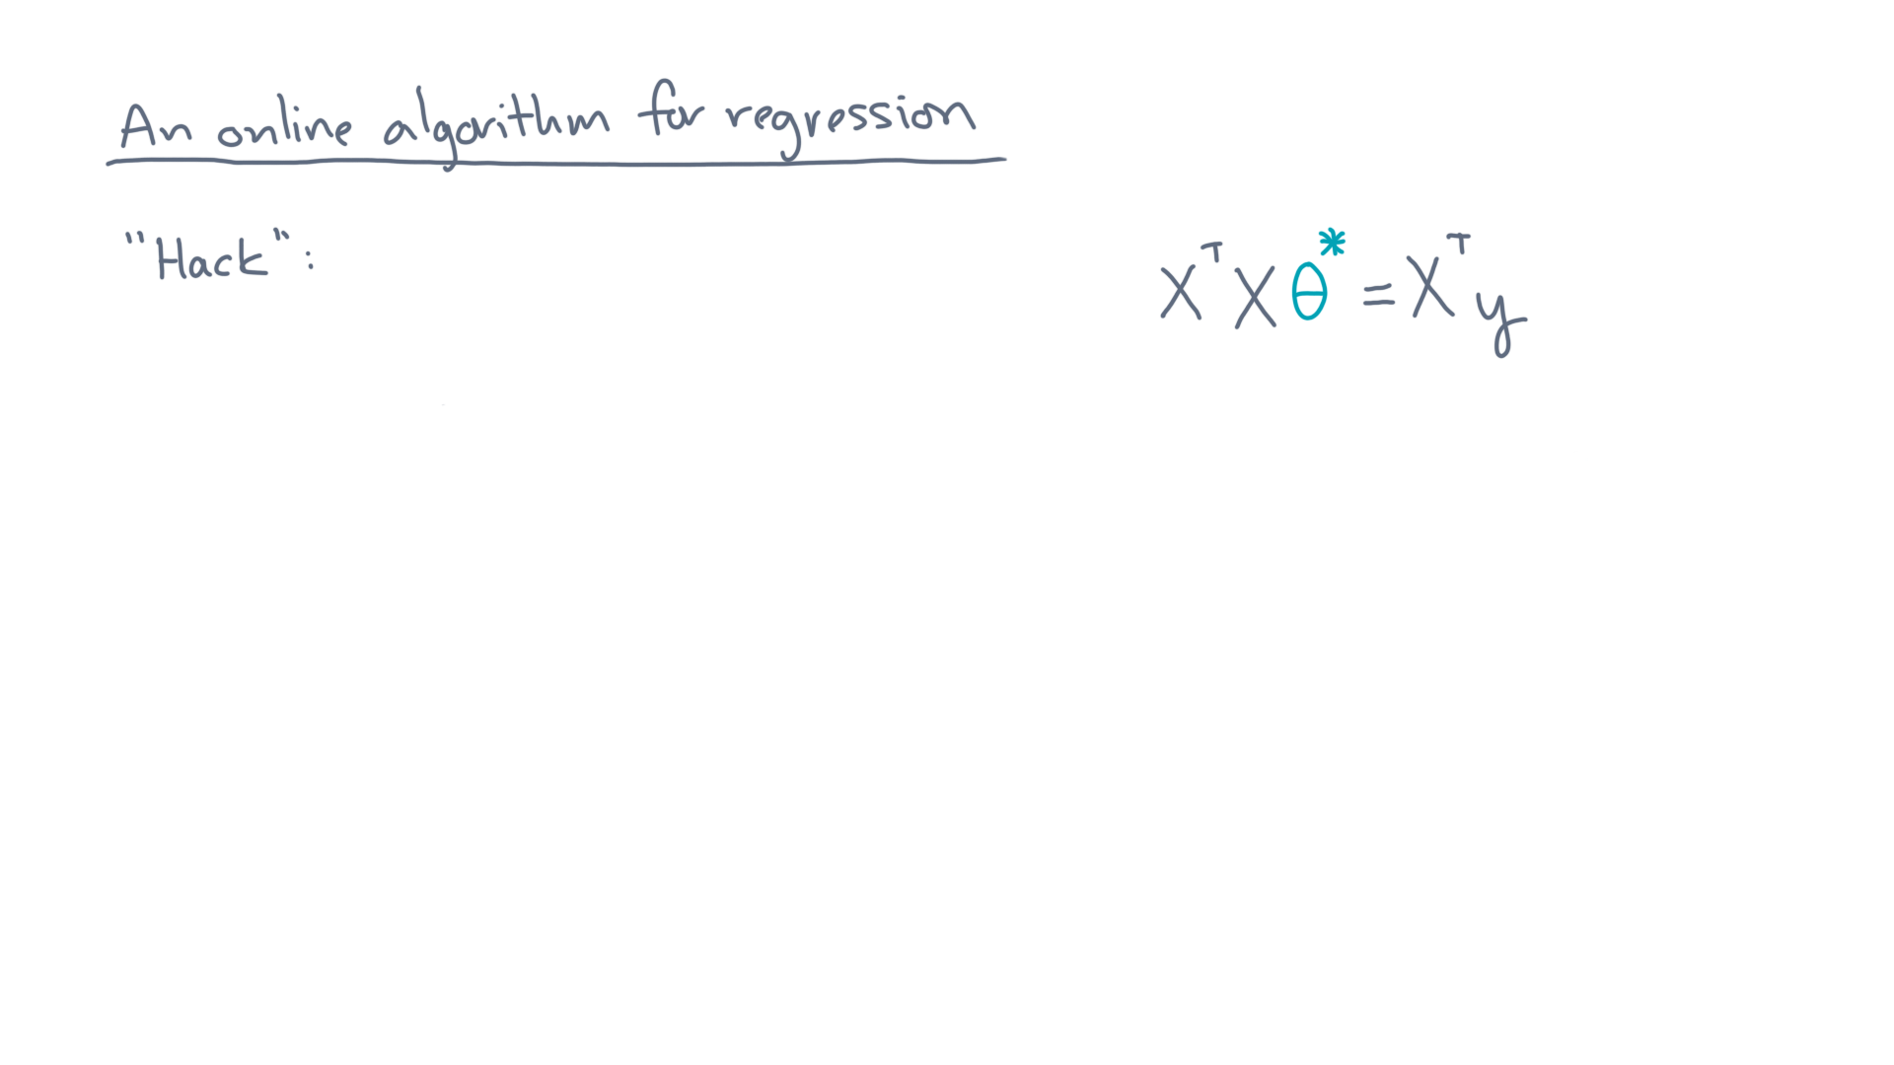
Notes:
So here’s a hack of that initial idea.

Slide 32
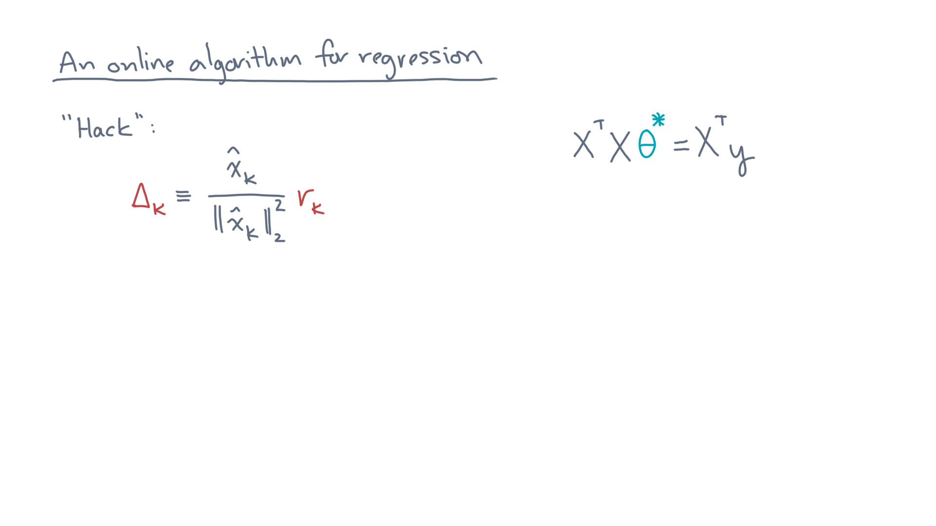
Notes:
Remember the original idea for a correction step?

Slide 33
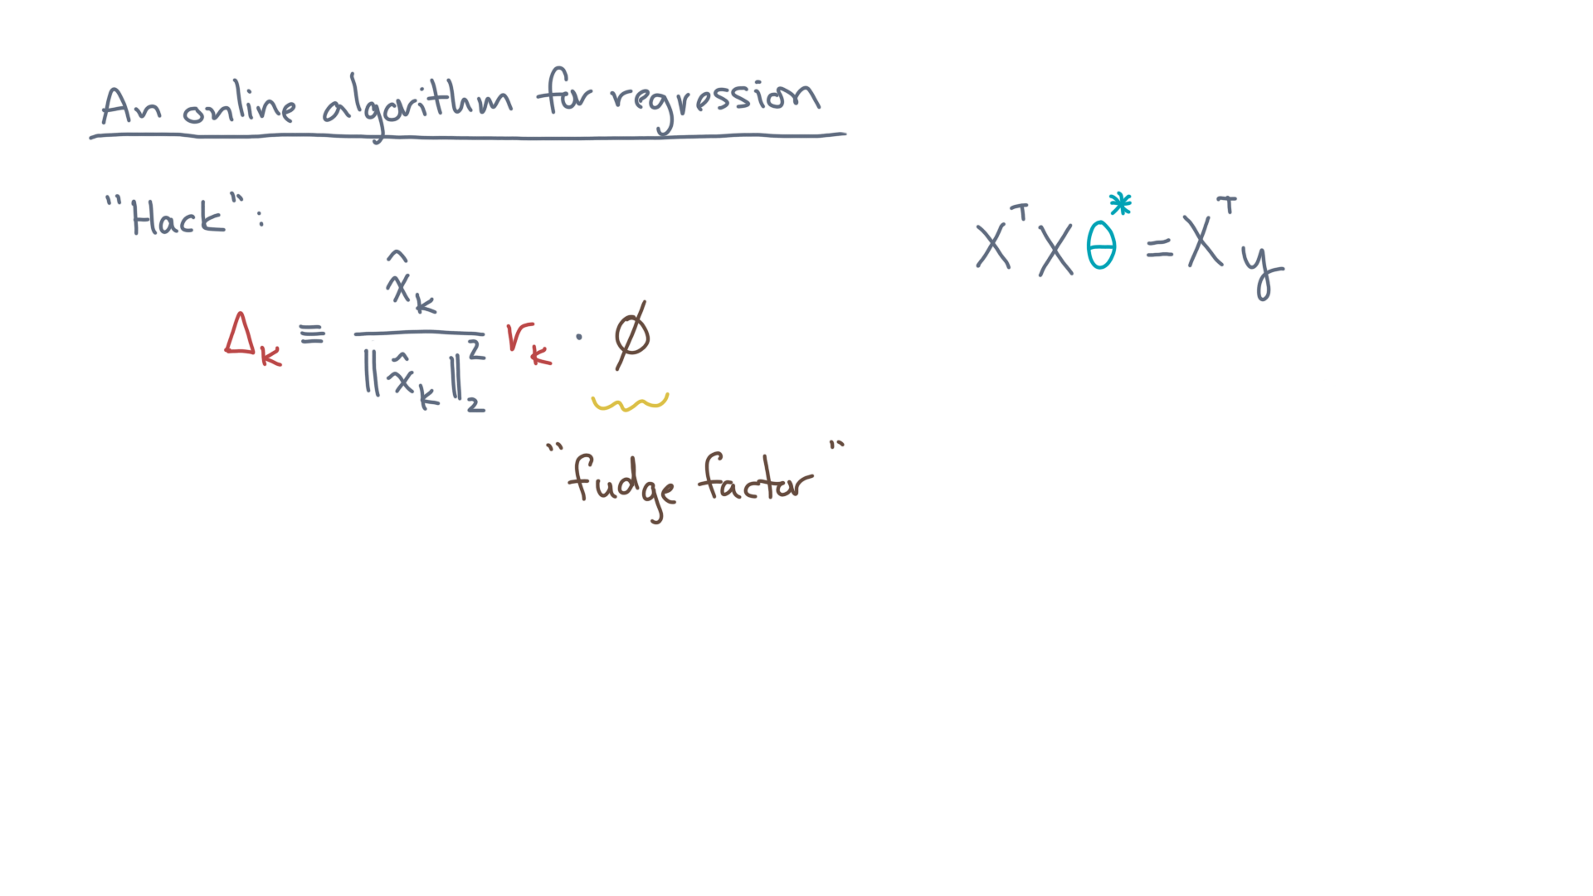
Notes:
Let’s multiply it by a “fudge factor,” phi.

Slide 34
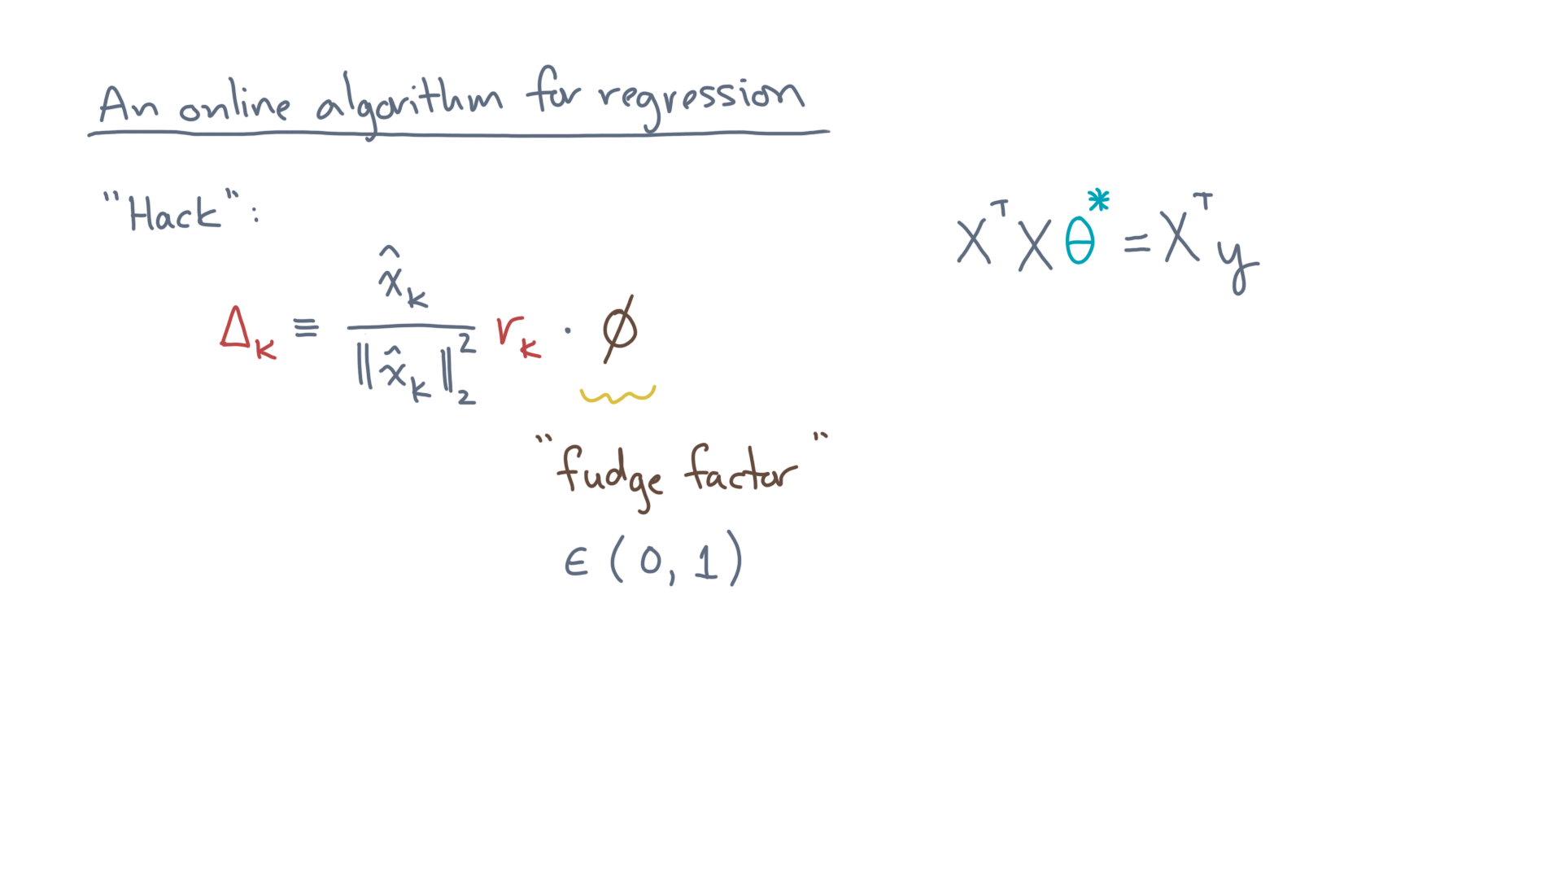
Notes:
In particular, suppose you pick phi between zero and one.
Then, instead of taking a “full step” in the direction of the new data point, you’re taking a partial step.

Slide 35
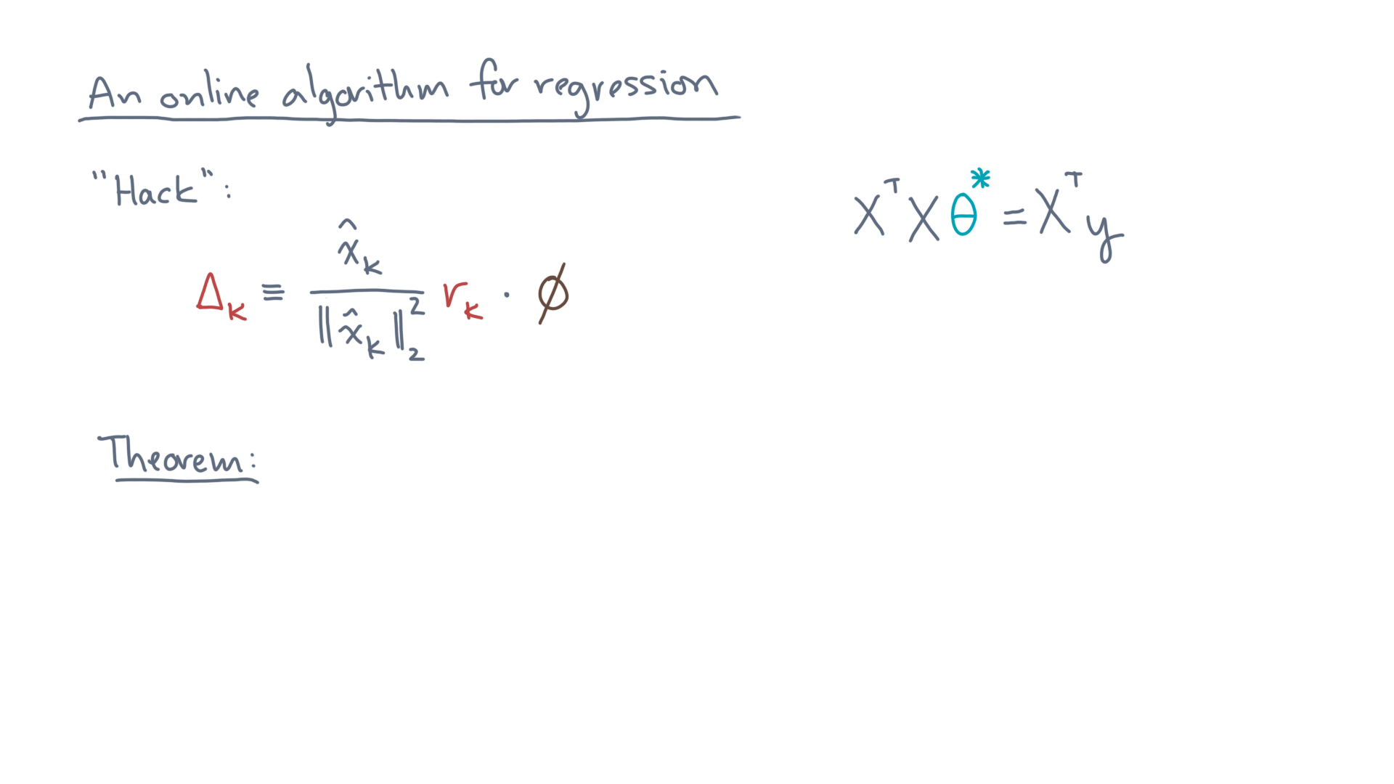
Notes:
And while it seems like a bad hack, there’s actually some theory to guide us in our choice of a value for phi.

Slide 36
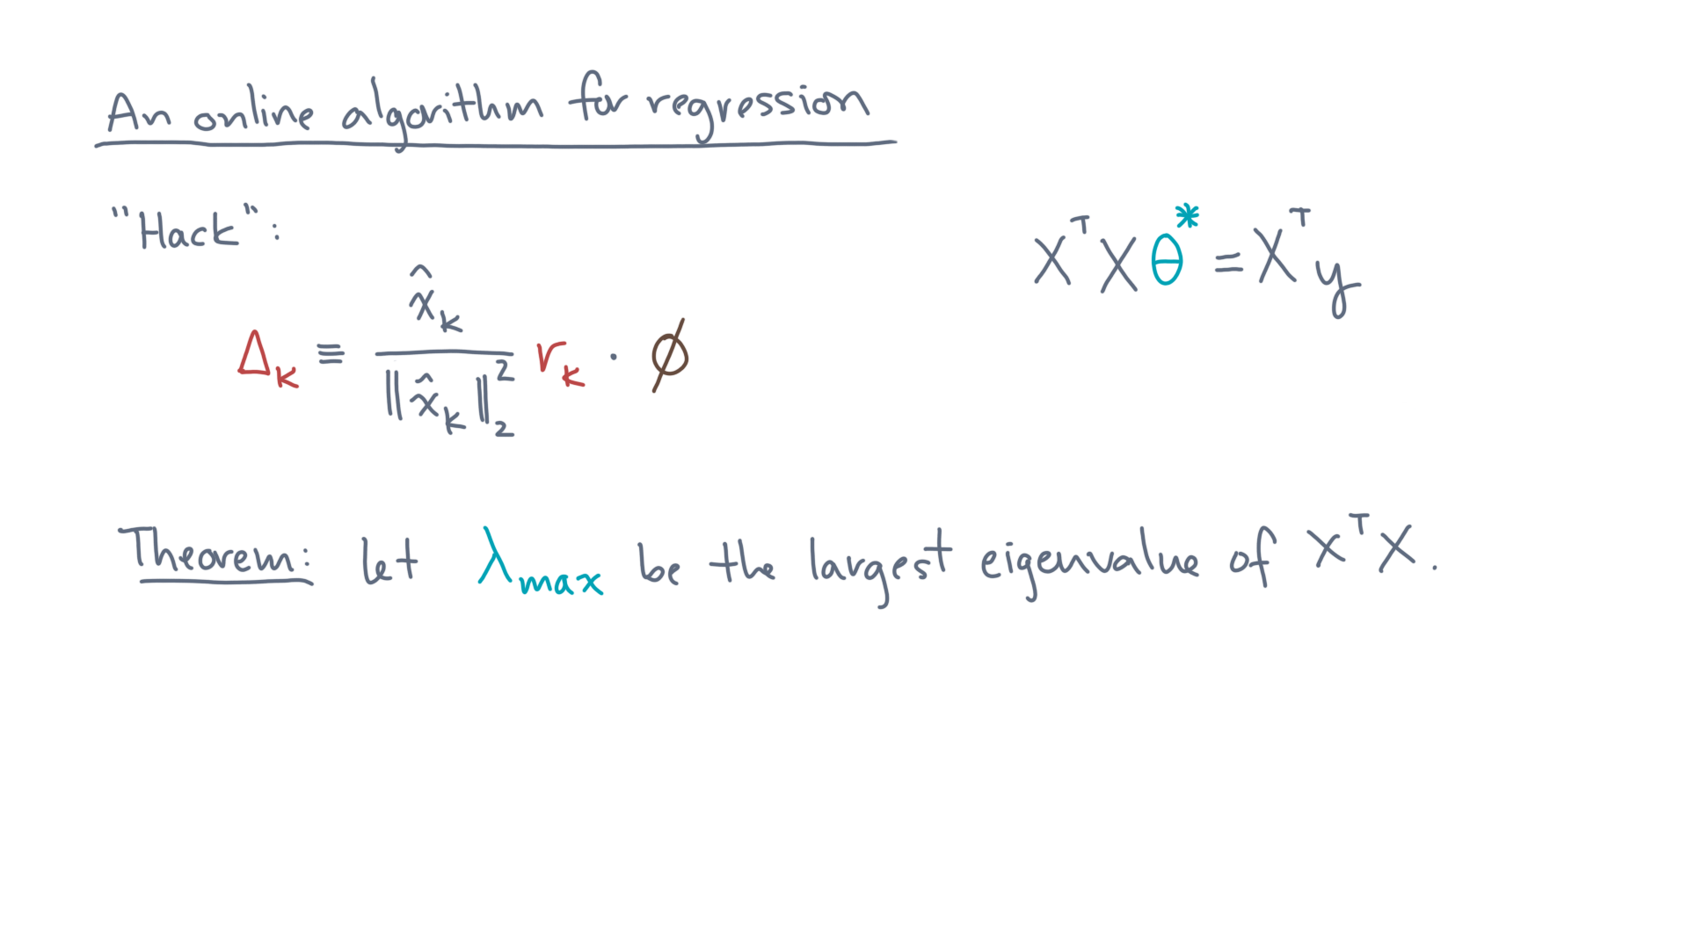
Notes:
Let lambda-max be the largest eigenvalue of X-transpose-X.

Slide 37
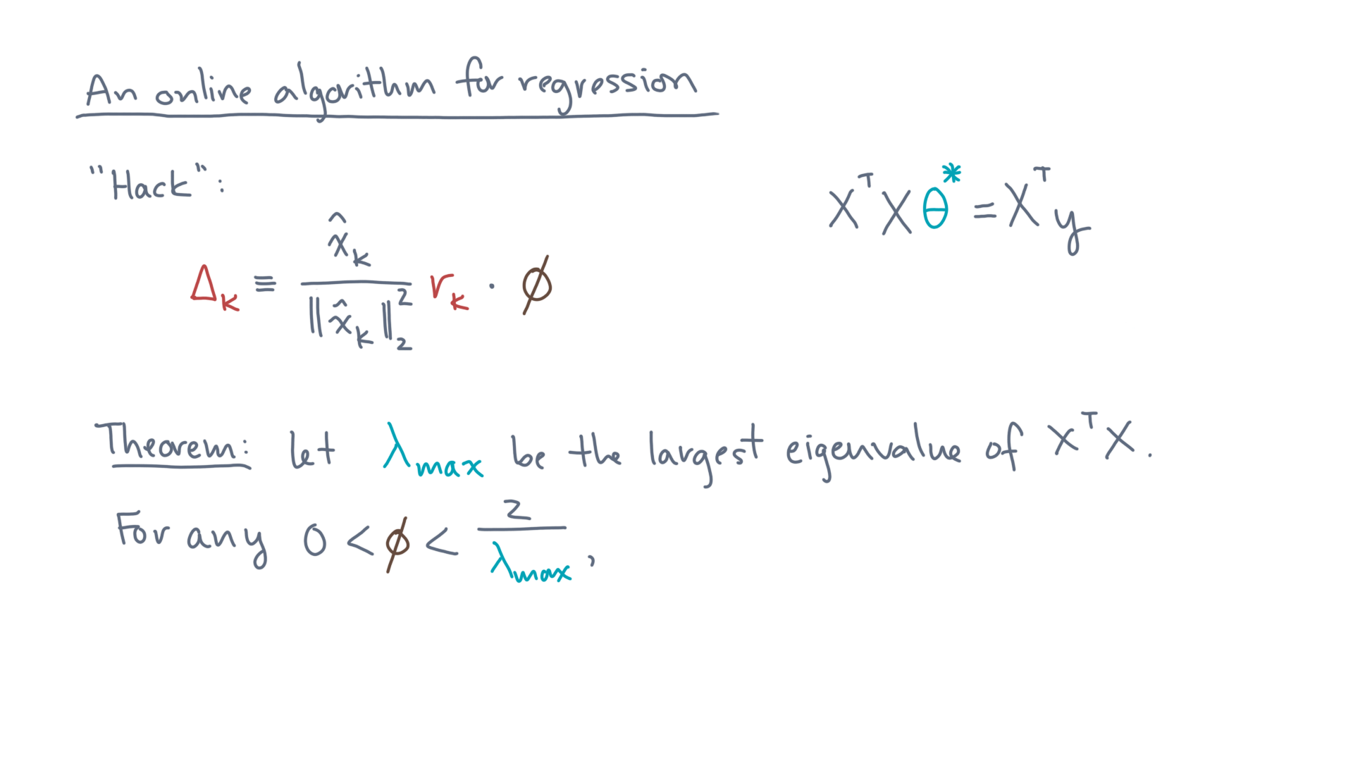
Notes:
Then consider any phi between 0 and 2 divided by this eigenvalue.

Slide 38
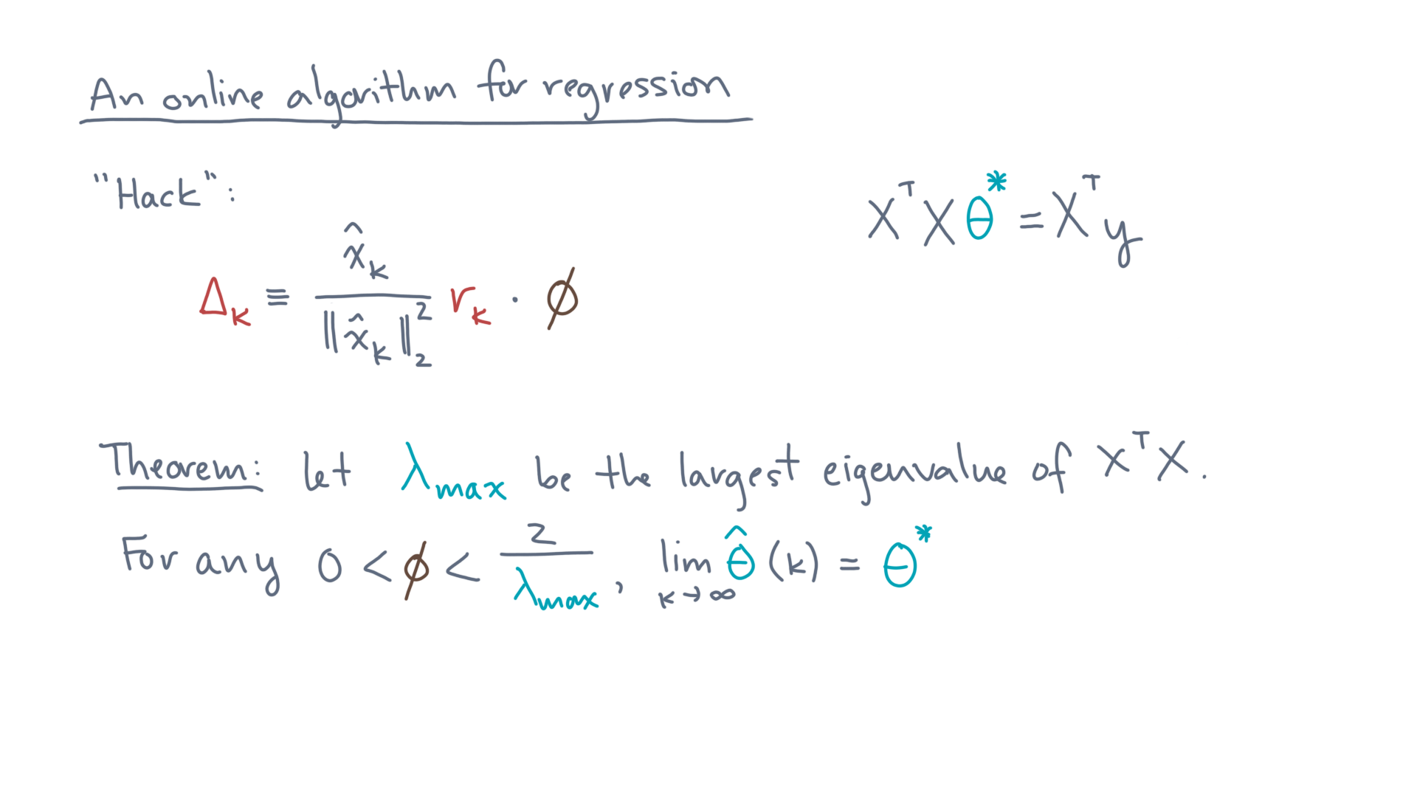
Notes:
Then in the limit, the estimated parameter will approach the exact solution!

Slide 39
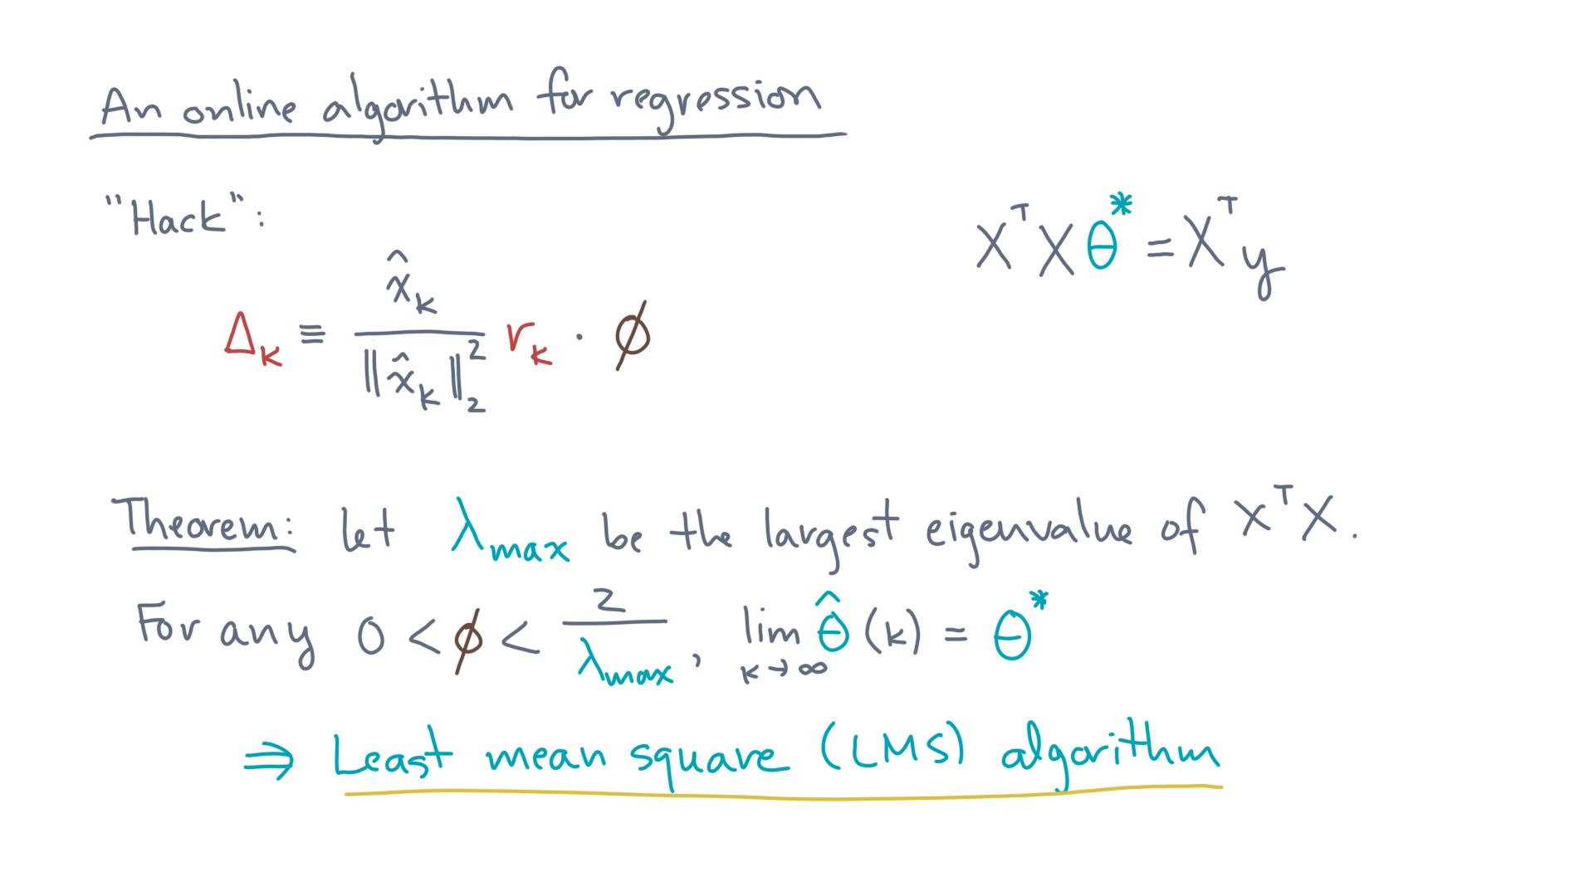
Notes:
This hack, including the analysis about how to choose phi, is known as the least-mean-square algorithm.
It’s pretty simple and neat, except for one thing.

Slide 40
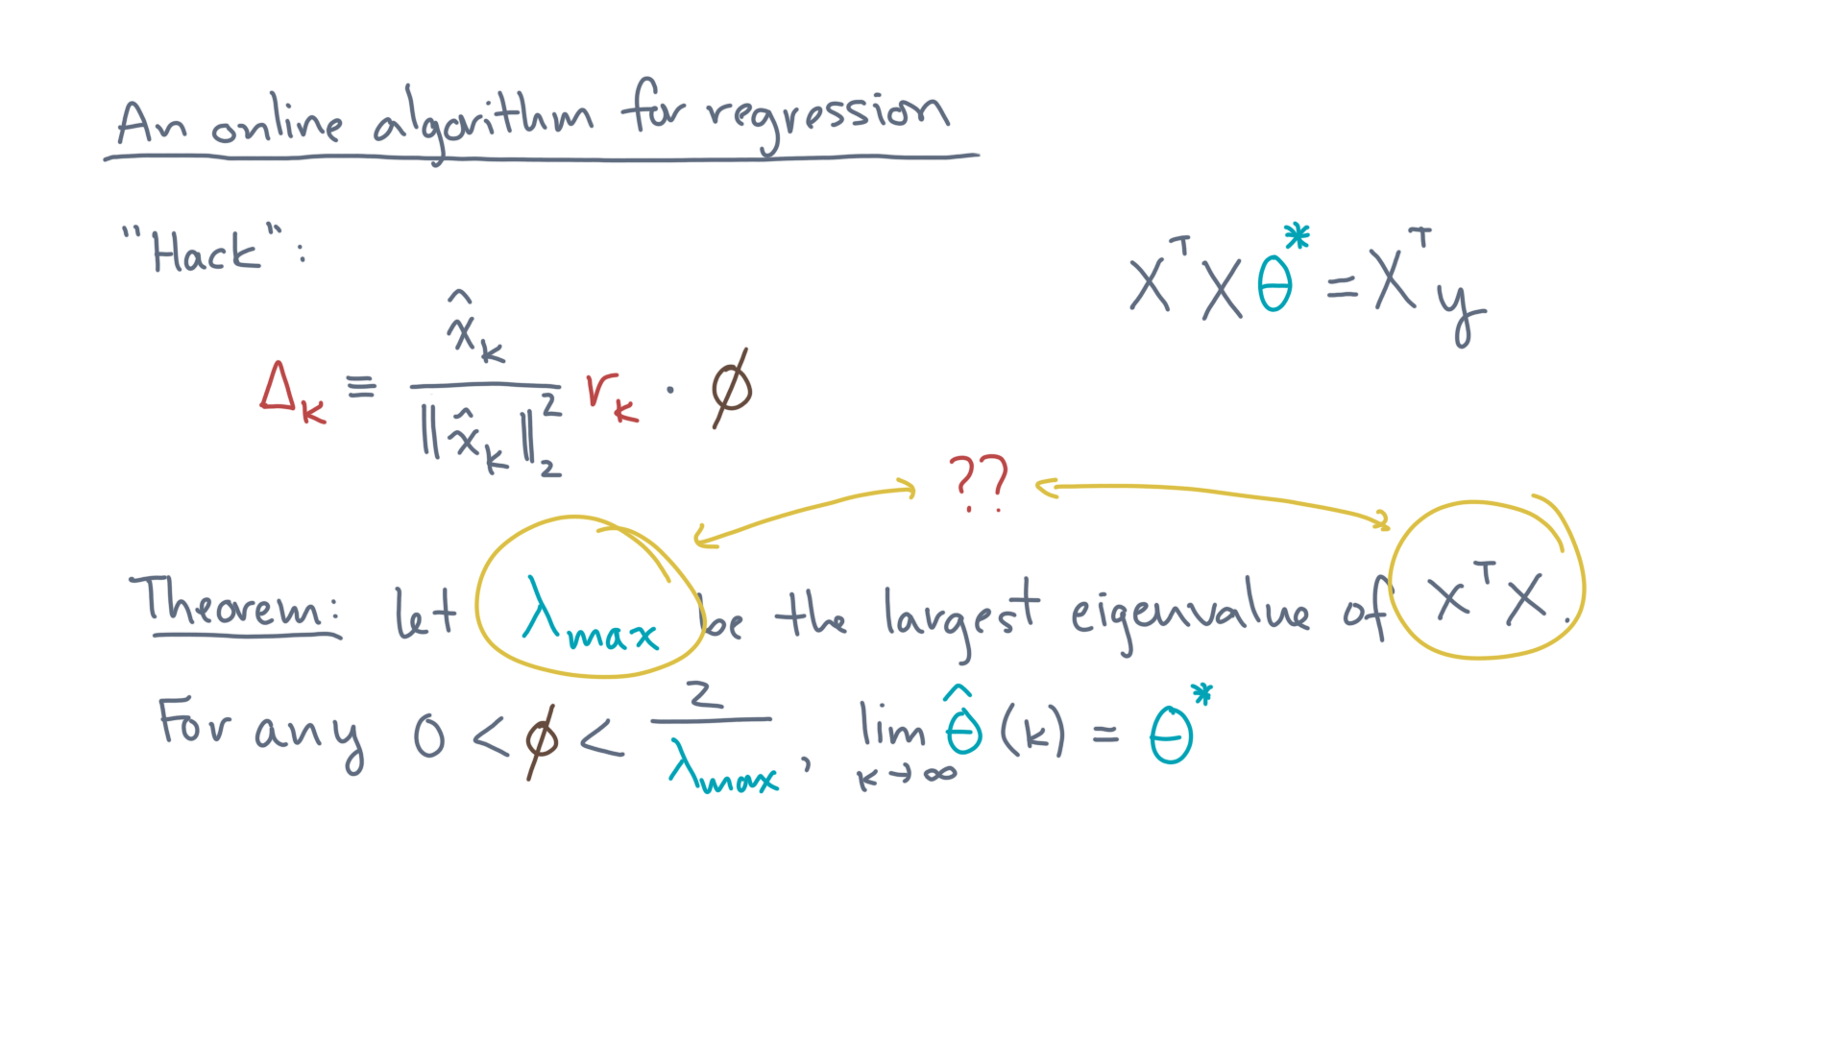
Notes:
We might not have any idea what this largest eigenvalue is until we’ve seen all of the data!

Slide 41
Notes:
As it stands, this online LMS scheme is not very satisfying, as it doesn’t seem immediately obvious how to make it work.
For that, what I’d like you to do now is switch to a notebook we created that walks you through some additional details.
It will summarize the LMS procedure and have you do some experiments to get a feel for how you might make it work in practice.

Slide 42
Notes:
And as you might have guessed, what we just sketched is just one of many other ideas for an online algorithm that look similar but try to improve on the LMS idea.
I hope this discussion, as well as the notebook, will be a good starting point for you to explore both batched and online techniques for this analysis problem along with many others.
Happy coding!

